Slide 1
Industrial Pharmacy II
By
Dr. Mohammed Sabbar
4th Oct. 2018
http://bit.do/ex2a6

Slide 2
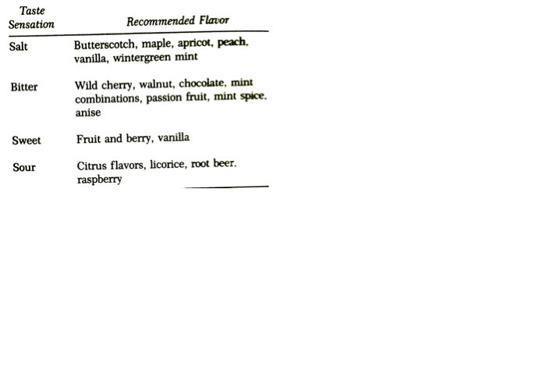
-Product Characteristics such as (sweetening agents, Viscosity control, Appearance)
Viscosity control
By sucrose or polyvinylpyrrolidone or cellulosic polymers like MC & CMC
Be aware from complexation with drug
Evaluation by viscometers or rheometer
Flavors
Selection and evaluation
Preliminary flavoring should be carried in diluted samples
Be aware from complexation with drug
Notes:
Evaluation by survey studies

Slide 3
-Product Characteristics such as (sweetening agents, Viscosity control, Appearance)
Appearance
Colour match with flavor
Clarity is important
Green or blue to mint
Red to berry
-Stability (Chemical & Physical)
Through out the shelf life of the products
- Chemical
- Physical
Color, flavor, odor, viscosity and taste
Integrity of sealing (cap and container)
Notes:
The evaluation of color, flavor, odor and viscosity should be carried by formulation chemist (pharmaceutical investigators).
While taste should be evaluate by a panel of unbiased (coded or blind study)

Slide 4
Manufacturing considerations
Like?
-Raw materials
-Equipments
-Compounding Procedure
-Packaging
Raw materials
Guarantee the spec. such as identity, purity, uniformity, freedom from MO contamination before going to manufacturing
Additional necessaries like PS
1-Water should meet the USP of purified water prepared by distillation or ion exchange
2-Sterilized water
Filter aids

Slide 5
Equipments
Mixing tanks equipped with agitators, measuring devices for small and large amounts of solids and liquids, filtration systems for clarity or sterilization,
Tanks usually polished with stainless steel and jacketed for …….
Transport of liquids into portable tanks should be by pumping (or gravity)
Distance between tanks should be minimum
A ware from contamination
All equipments should be easily disassemble, clean and sanitize

Slide 6
Compounding procedure
Dilute solutions are rapidly prepared by charging the solute to solvent and agitating until solution is homogenous.
Concentrated solution by slow dissolvement may need heat
Solution of small concentrations of solids should priory prepared
Two solutions of two solvent???

Slide 7
Packaging
Containers and caps
?1 glass or plastic
?2 Amber or white or colorless

Slide 8
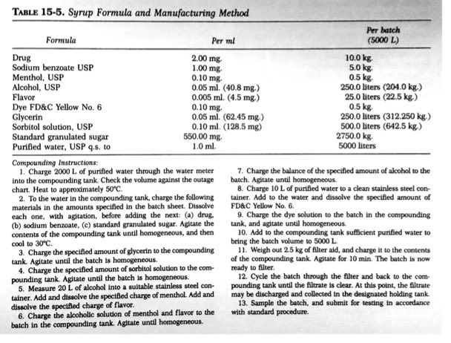

Slide 9
Diazepam Injection
Bill of Materials (Batch Size 1 L)
Item Material Qty
1/ Diazepam, USP 5.00 g
2/ Benzoic acid 1.00 g
3/ Alcohol absolute, USP 100.00 g
4/ Propylene glycol 400.00 g
5/ Sodium benzoate 49.00 g
6/ Benzyl alcohol 15.00 g
7/ Water for injection, USP QS to 1.00 L
8/ Nitrogen gas, NF QS cy
9/ Sodium hydroxide for pH adjustment QS mL
10/ Hydrochloric acid for pH adjustment QS mL
Manufacturing Directions
Note: The following operations must be carried out under aseptic conditions. All containers and filters must be sterilized. The equipment that cannot be sterilized must be washed with 3% solution of benzyl alcohol and rinsed with sterilized water. Protect the solution from light. If directions are not followed strictly, diazepam may crystallize out.
Notes:
1. Add item 2 and item 1 to item 3 previously heated to 30C to 35C and stir to complete solution.
2. Separately dissolve item 4 in item 6.
3. Separately dissolve item 5 in the first portion of item 7. 8 bubble through the solution for 30 minutes and then filter.
4. Pool together solutions of steps 1 and 2. And cautiously add solution in step 3 with stirring.
5. Bring to volume with item 7. Mix and let item 8 bubble through the solution for 30 minutes.
6. Check and adjust pH to 6.5 to 7.2 with item 9 or 10.
7. Filter the solution through a 0.15-mm Sartorius filter and collect filtrate in a glass container.
8. Fill into ampoules under N2 atmosphere through a 0.22-mm filter.

Slide 10
Quality Assurances
According to regulation or registration protocol
Mostly as in Pharmacopoeia (s)

Slide 11
USP

